Slide 1
Database Management Systems

Slide 2
Supertypes and Subtypes
Subtype: A subgrouping of the entities in an entity type that has attributes distinct from those in other subgroupings
Supertype: A generic entity type that has a relationship with one or more subtypes
Attribute Inheritance:
Subtype entities inherit values of all attributes of the supertype
An instance of a subtype is also an instance of the
supertype

Slide 3
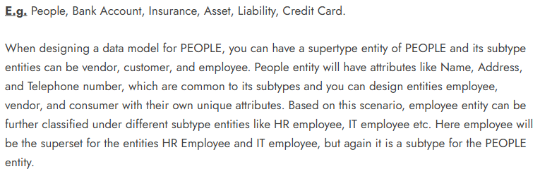
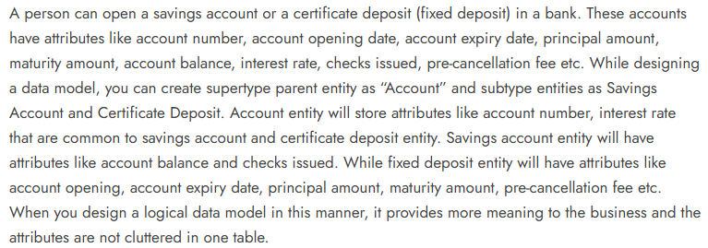

Slide 4
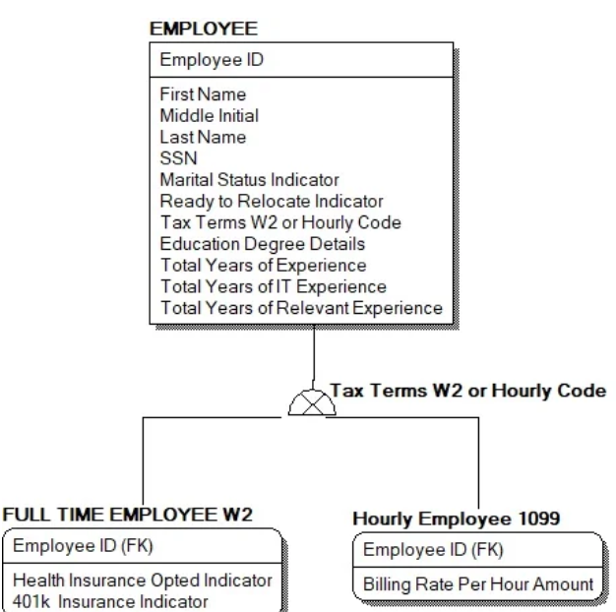

Slide 5
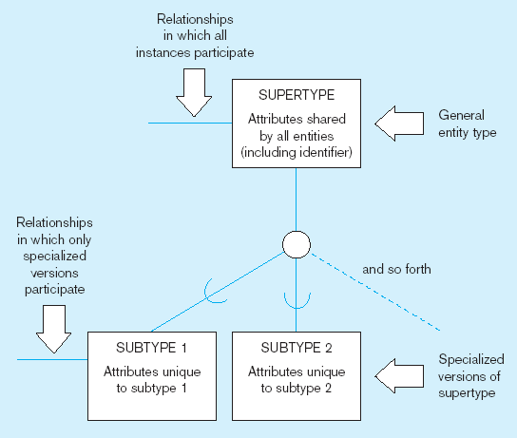
Basic notation for supertype/subtype notation
a) EER
notation

Slide 6
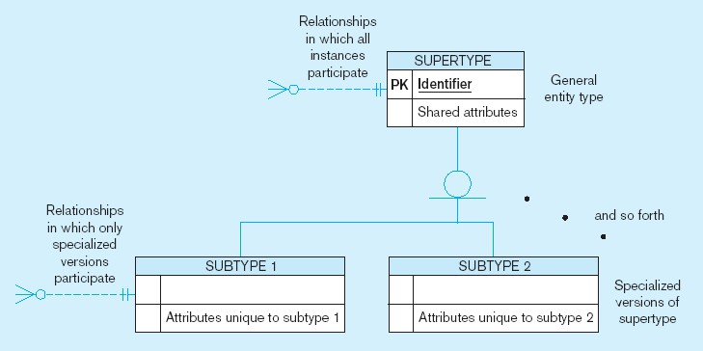
Basic notation for supertype/subtype notation (cont.)
b) Microsoft
Visio
Notation
Different modeling tools may have different notation for the same modeling constructs

Slide 7
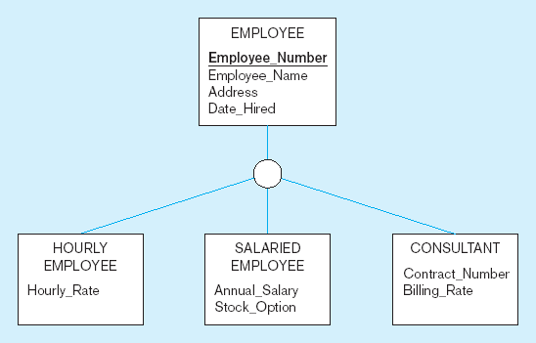
Employee supertype with three subtypes
All employee subtypes will have emp nbr, name, address, and date-hired
Each employee subtype will also have its own attributes

Slide 8
Relationships and Subtypes
Relationships at the supertype level indicate that all subtypes will participate in the relationship
The instances of a subtype may participate in a relationship unique to that subtype. In this situation, the relationship is shown at the subtype level

Slide 9
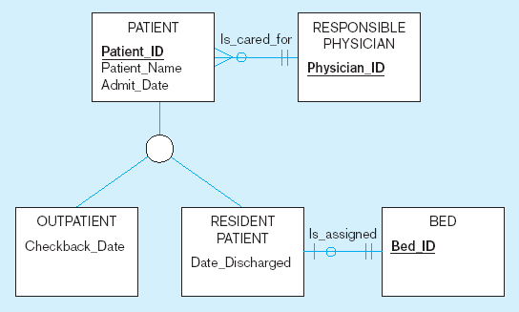
Supertype/subtype relationships in a hospital
Both outpatients and resident patients are cared for by a responsible physician
Only resident patients are assigned to a bed

Slide 10
Generalization and Specialization
Generalization: The process of defining a more general entity type from a set of more specialized entity types. BOTTOM- UP
Specialization: The process of defining one or more subtypes of the supertype and forming supertype/subtype relationships. TOP-DOWN

Slide 11
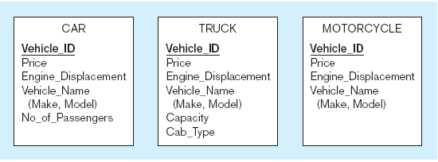
Example of generalization
a) Three entity types: CAR, TRUCK, and MOTORCYCLE
All these types of vehicles have common attributes

Slide 12
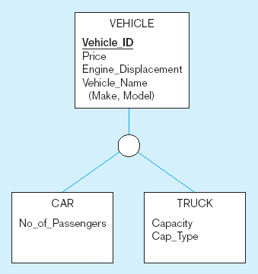
Example of generalization (cont.)
b) Generalization to VEHICLE supertype
So we put the shared attributes in a supertype
Note: no subtype for motorcycle, since it has no unique attributes

Slide 13
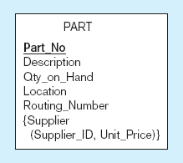
Example of specialization
a) Entity type PART
Only applies to manufactured parts
Applies only to purchased parts

Slide 14
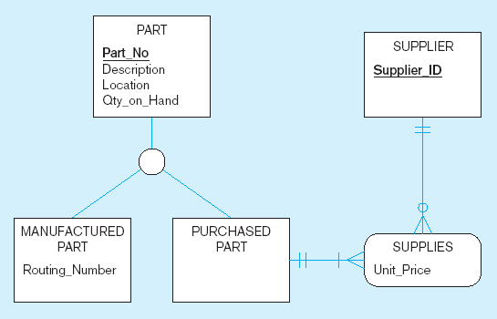
Example of specialization (cont.)
b) Specialization to MANUFACTURED PART and PURCHASED PART
Created 2 subtypes
Note: multivalued attribute was replaced by an associative entity relationship to another entity

Slide 15
Constraints in Supertype/ Completeness Constraint
Completeness Constraints: Whether an instance of a supertype must also be a member of at least one subtype
Total Specialization Rule: Yes (double line)
Partial Specialization Rule: No (single line)

Slide 16
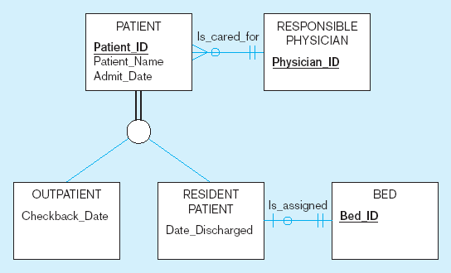
Examples of completeness constraints
a) Total specialization rule
A patient must be either an outpatient or a resident patient

Slide 17
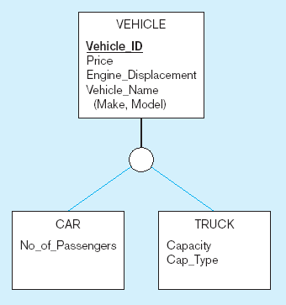
Examples of completeness constraints (cont.)
b) Partial specialization rule
A vehicle could be a car, a truck, or neither

Slide 18
Constraints in Supertype/ Disjointness constraint
Disjointness Constraints: Whether an instance of a supertype may simultaneously be a member of two (or more) subtypes
Disjoint Rule: An instance of the supertype can be only ONE of the subtypes
Overlap Rule: An instance of the supertype could be more than one of the subtypes

Slide 19
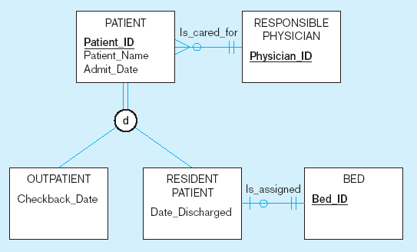
Examples of disjointness constraints
a) Disjoint rule
A patient can either be outpatient or resident, but not both

Slide 20
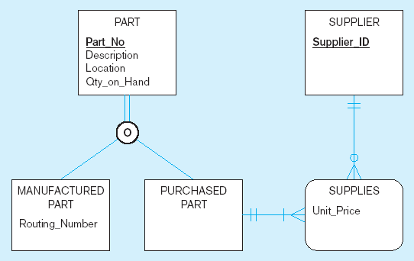
Examples of disjointness constraints (cont.)
b) Overlap rule
A part may be both purchased and manufactured

Slide 21
Constraints in Supertype/ Subtype Discriminators
Subtype Discriminator: An attribute of the supertype whose values determine the target subtype(s)
Disjoint – a simple attribute with alternative values to
indicate the possible subtypes
Overlapping – a composite attribute whose subparts pertain to different subtypes. Each subpart contains a boolean value to indicate whether or not the instance belongs to the associated subtype

Slide 22
Introducing a subtype discriminator (disjoint rule)
A simple attribute with different possible values indicating the subtype

Slide 23
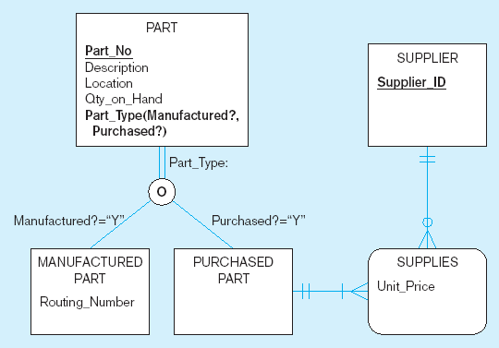
Subtype discriminator (overlap rule)
A composite attribute with sub-attributes indicating “yes” or “no” to determine whether it is of each subtype

Slide 24
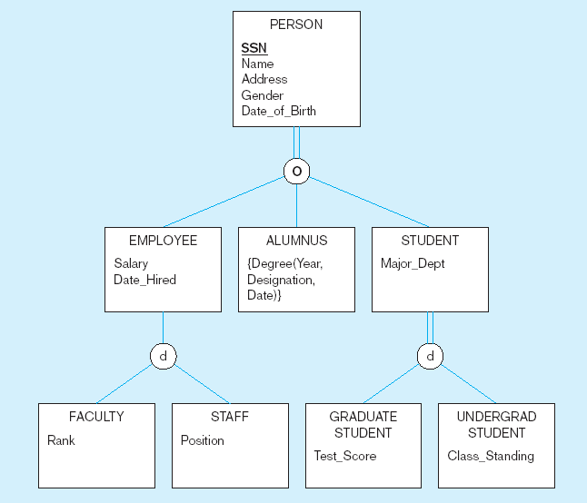
Example of supertype/subtype hierarchy

